Slide 1
4506 – C
DataVerify

Slide 2
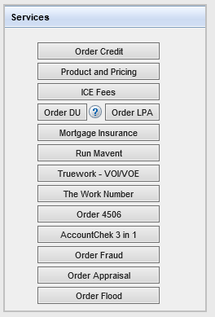
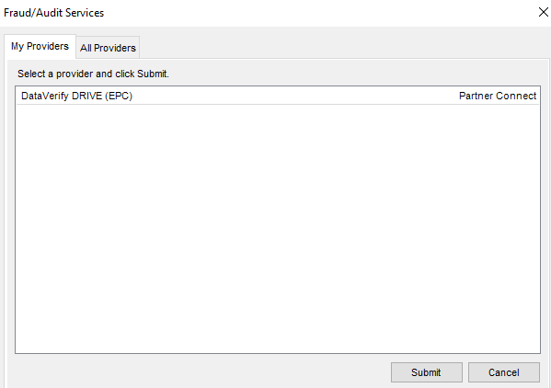
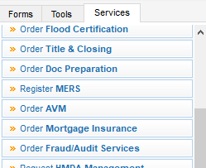
4506 - C
For the ordering of tax transcripts, you can access Dataverify through either the services screen on the M/I Borrower Summary or within the Services tab.
For the ordering of tax transcripts, you can access Dataverify through either the services screen on the M/I Borrower Summary or within the Services tab.

Slide 3
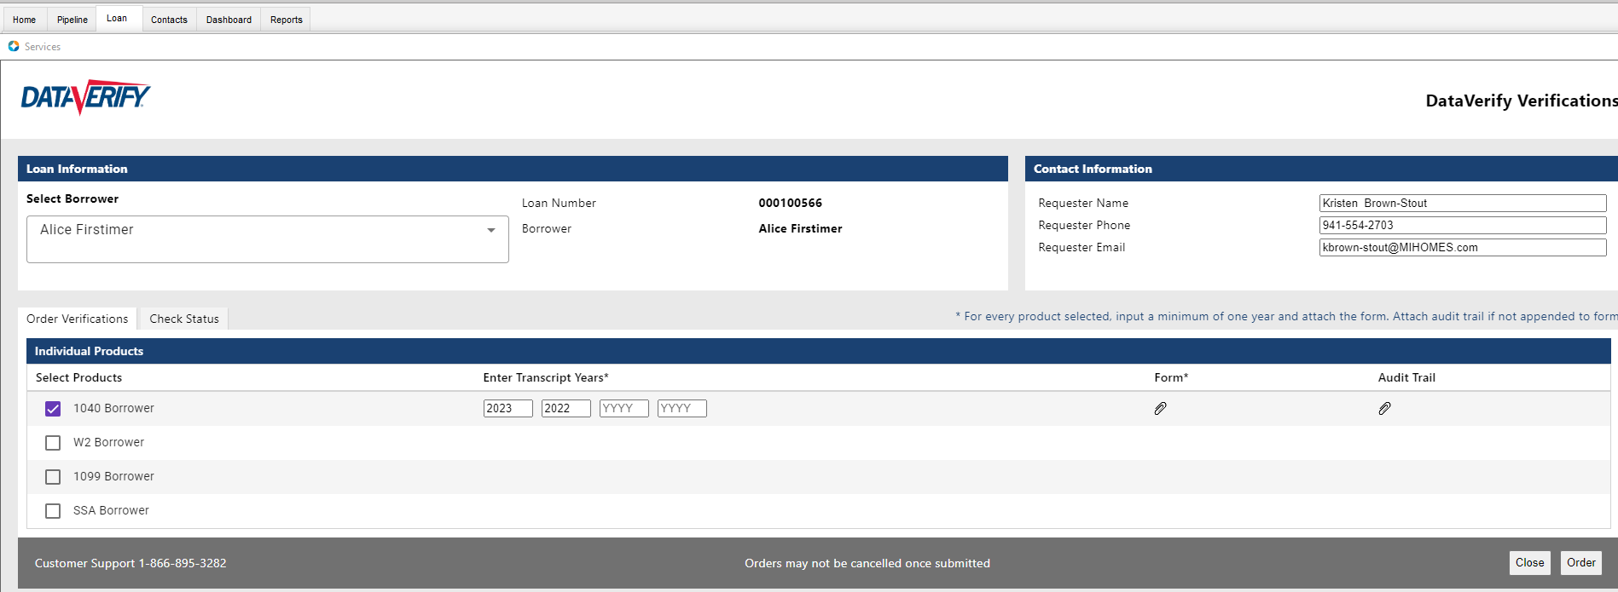
Ordering through DataVerify
Both the order 4506 or order Fraud/Audit services will bring you to the DataVerify system in order to complete a 4506 request.
Both the order 4506 or order Fraud/Audit services will bring you to the DataVerify system in order to complete a 4506 request.

Slide 4
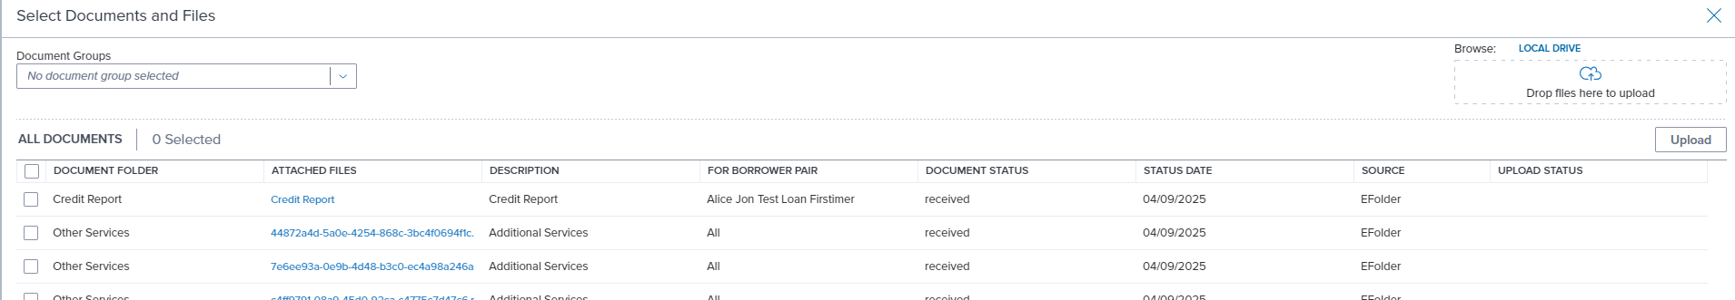
Ordering through DataVerify
You can check or add additional forms to the order through the Form attachment by clicking on the paperclip. You can also update the transcript years in this screen and place your order.
You can check or add additional forms to the order through the Form attachment by clicking on the paperclip. You can also update the transcript years in this screen and place your order.

Slide 5
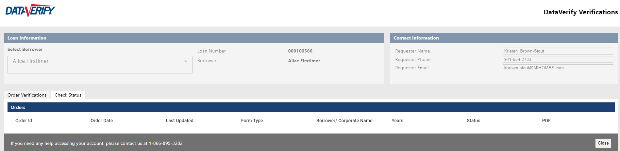
Ordering through Dataverify
You can also check the status of an order.
Press the Check Status tab to get an update
on your order.

Slide 6
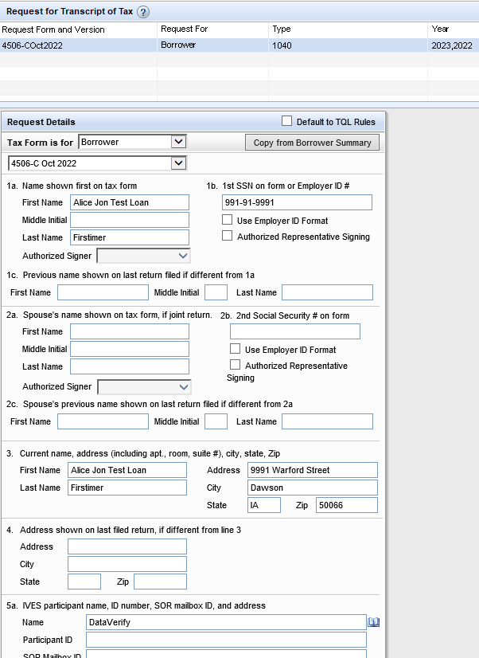

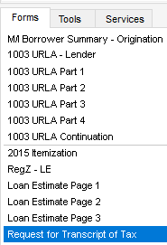
Request for Transcript Tax Form
You can update the tax transcript tax form with the most recent information, so your request can be the most accurate. Under Request Details, you can select which borrowers you want to update the information for.
You can update the tax transcript tax form with the most recent information, so your request can be the most accurate. Under Request Details, you can select which borrowers you want to update the information for.
If you are requesting transcripts for a business, specify the company name and employer identification number on lines 1a and 1b.
Make sure you are checking your information for accuracy. Most returns are due to missed checked boxes, addresses incorrect, or years needed.
If you are requesting transcripts for a business, specify the company name and employer identification number on lines 1a and 1b.

Slide 7
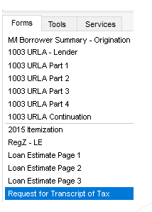
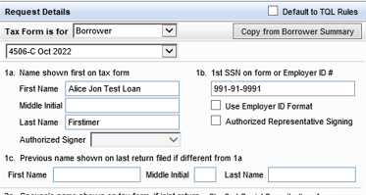
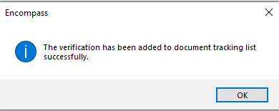

Request 4506 Tax form
If you need to send an updated request to the borrower for the 4506, you can do so through the eFolder.
Update the information in, Forms, Request for Transcript of Tax.
Add the form to the eFolder.
If you need to send an updated request to the borrower for the 4506, you can do so through the eFolder.
Update the information in, Forms, Request for Transcript of Tax.
Add the form to the eFolder.
1
2

Slide 8
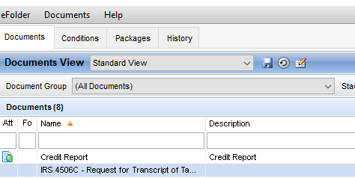

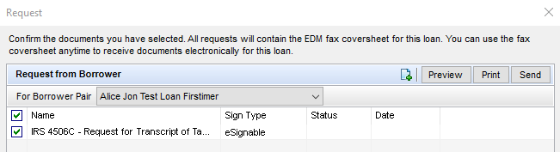
Request 4506 Tax form
If you need to send an updated request to the borrower for the 4506, you can do so through the eFolder.
3. Open up the eFolder.
4. Highlight the IRS 4506C and press the request button.
5. Preview the form and then send it to the borrow.
It will send via Consumer Connect for the borrower to sign.
3
If you need to send an updated request to the borrower for the 4506, you can do so through the eFolder.
3. Open up the eFolder.
4. Highlight the IRS 4506C and press the request button.
5. Preview the form and then send it to the borrow.
It will send via Consumer Connect for the borrower to sign.
4
5

Slide 9
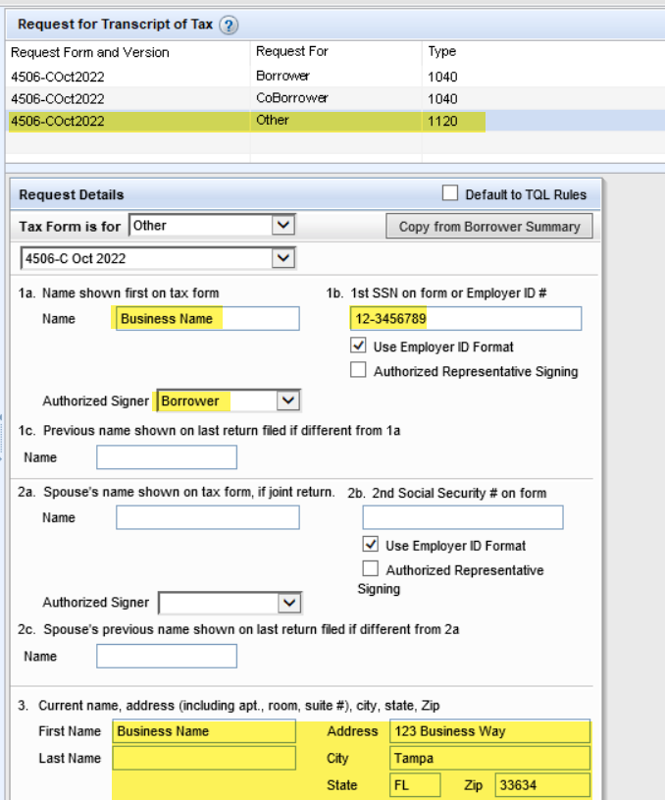
Business Request for Transcript
If you are requesting transcripts for a business, please follow the steps. It is important to specify “other” as the “Request For” to ensure it accurately prints with disclosure packages.

Slide 10
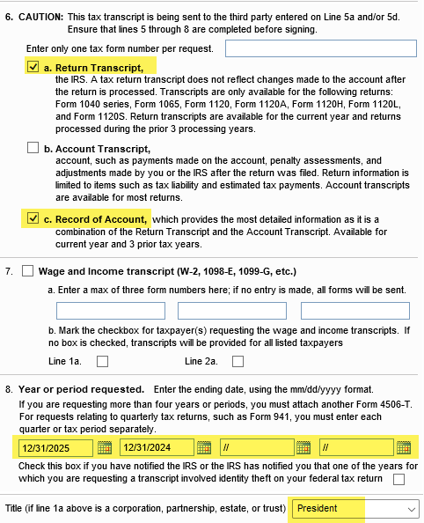
Business Request for Transcript
If you are requesting transcripts for a business, please follow the steps. It is important to specify “other” as the “Request For” to ensure it accurately prints with disclosure packages.

Slide 11
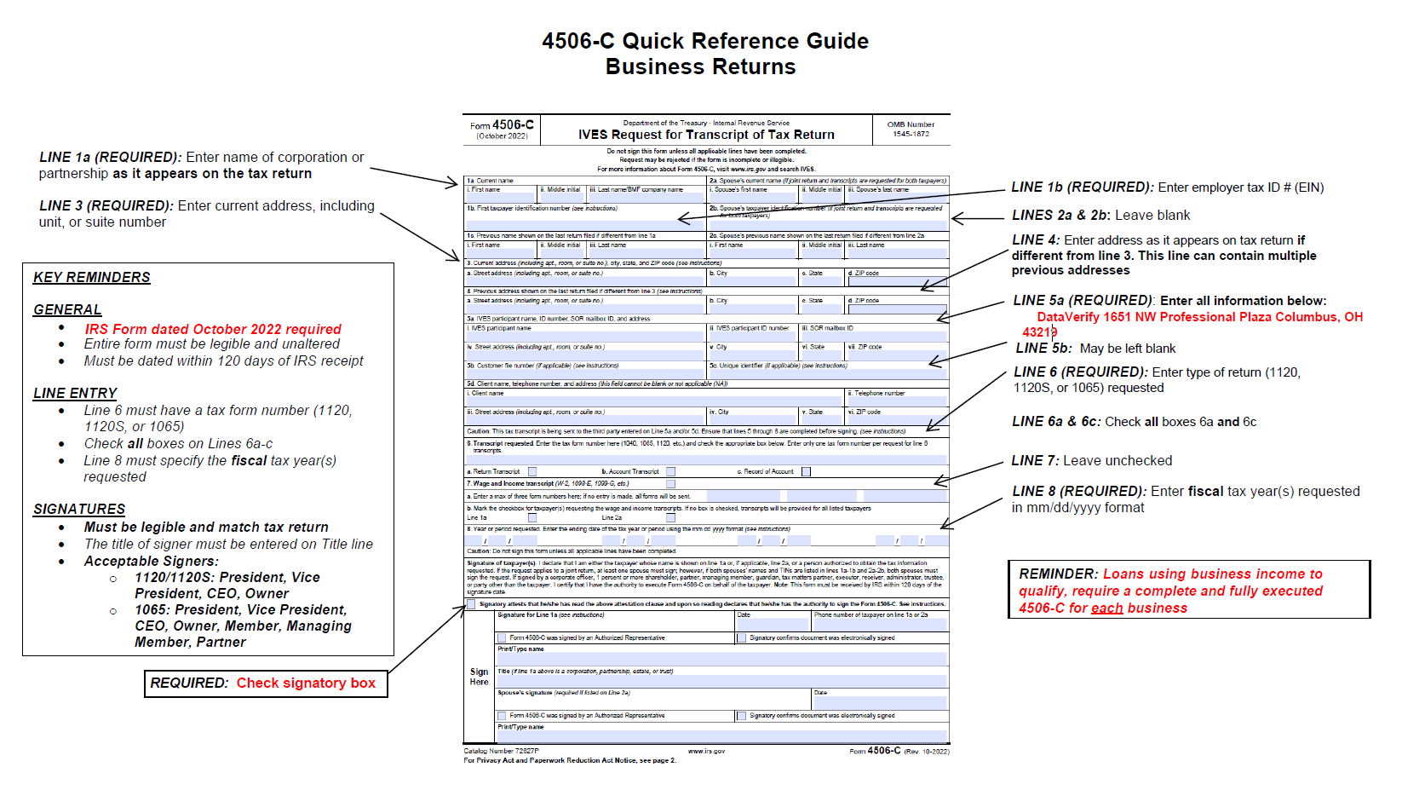
Business Return 4506-C Quick Reference Guide

Slide 12





