Slide 1
Escrow Holdbacks

Slide 2
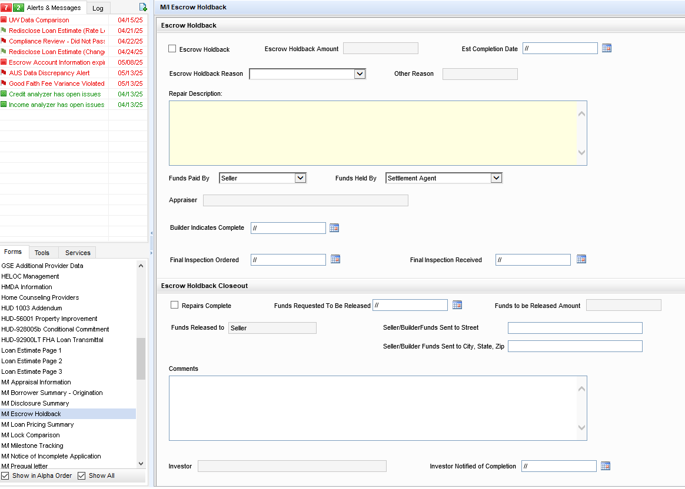
Escrow Holdbacks
Escrow Holdbacks have one centralized screen.
Under Forms, M/I Escrow Holdback.
Escrow Holdbacks have one centralized screen.
Under Forms, M/I Escrow Holdback.

Slide 3
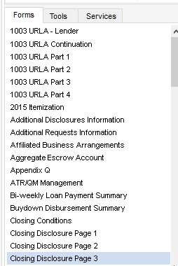
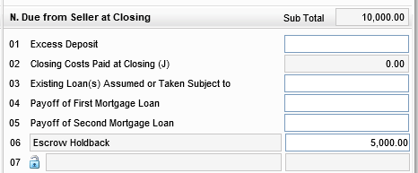
Escrow Holdbacks
To start your escrow holdback, you will need to enter your amount in the Closing Disclosure page 3 section, in forms.
To start your escrow holdback, you will need to enter your amount in the Closing Disclosure page 3 section, in forms.

Slide 4

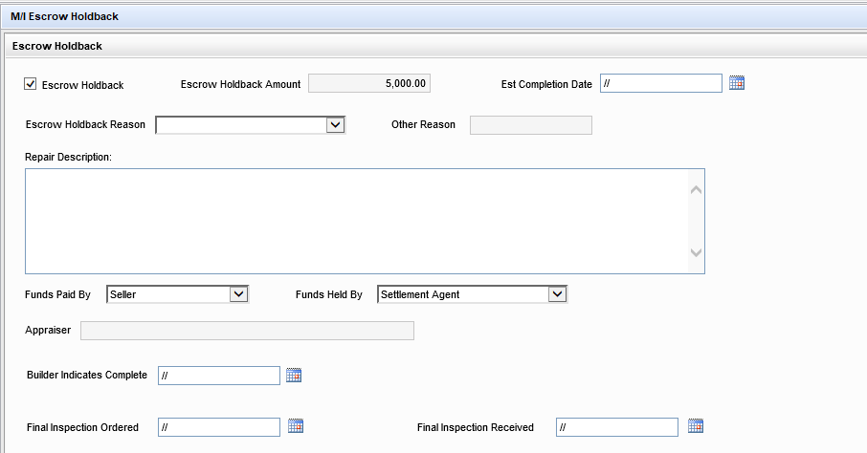
Escrow Holdbacks
Once the escrow amount is entered, you will need to go into the M/I Escrow Holdback screen under Forms.
The Escrow Holdback button is marked, and amount comes from CD page 3, L 06.
Enter an estimated completion date.
Use the dropdown to complete the reason.
List out each escrow item in the repair description.
Press the Save button.
Once the escrow amount is entered, you will need to go into the M/I Escrow Holdback screen under Forms.
The Escrow Holdback button is marked, and amount comes from CD page 3, L 06.
Enter an estimated completion date.
Use the dropdown to complete the reason.
List out each escrow item in the repair description.
Press the Save button.

Slide 5
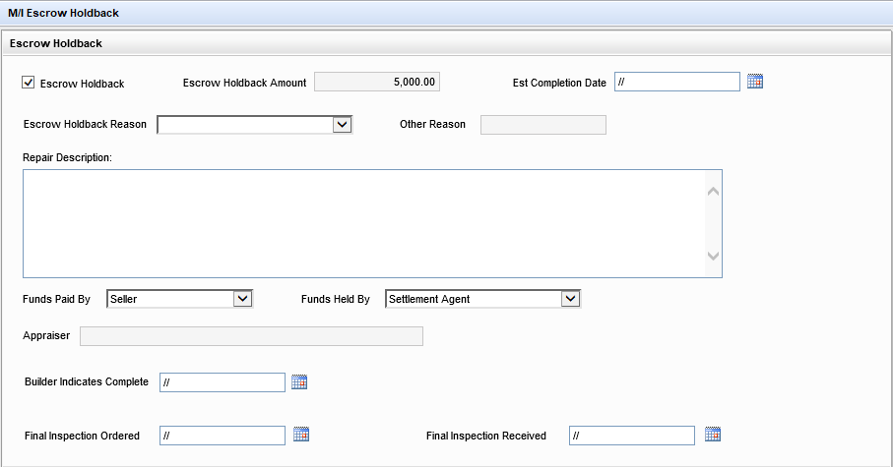
Escrow Holdbacks
Once the builder indicates that the escrow work is completed you will go back into the M/I Escrow Holdback screen and update the builder complete date and order the final inspection.
Once the builder indicates that the escrow work is completed you will go back into the M/I Escrow Holdback screen and update the builder complete date and order the final inspection.

Slide 6
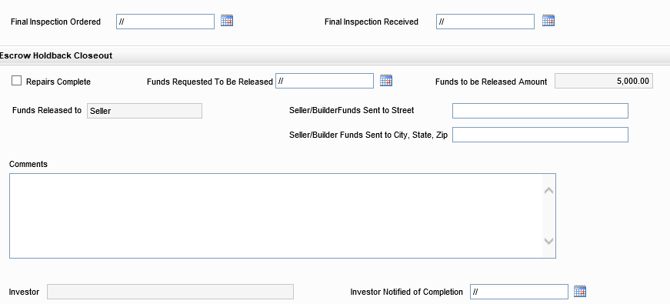
Escrow Holdback
When the final inspection is received, go back into your M/I Escrow Holdback screen.
Enter the Final Inspection Received date.
Checkmark Repairs Complete.
Request funds to title to be released to the builder.
Add any comments relevant to the escrow holdback.
Email Post Closing once funds are released and escrow holdback is complete.
When the final inspection is received, go back into your M/I Escrow Holdback screen.
Enter the Final Inspection Received date.
Checkmark Repairs Complete.
Request funds to title to be released to the builder.
Add any comments relevant to the escrow holdback.
Email Post Closing once funds are released and escrow holdback is complete.

Slide 7





