Slide 1
M/I Financial
House to Sell Program
Year End Special 2026

Slide 2
HTS Program Overview
What is HTS Program?
The HTS program was designed to assist the M/I Home Buyer in selling their existing home by providing their buyer a lender contribution (credit) at time of closing.
Since we are an interested party to the transaction, you will need to comply with the interested party contributions for Conventional, FHA and VA.

Slide 3
HTS Program Overview
Scope: M/I Financial will contribute up to 3% of the Sales Price of the M/I Homes purchasers existing home. (Example: Sales Price = $500,000 with M/I Financial contributing $15,000). The contribution can be used to buy down interest rate or pay for closing costs.
Required Loans: Both the M/I Homes buyer, and the buyer’s buyer need to finance with M/I Financial to take advantage of this program.
Pricing: There is no ALP or Pricing Exceptions for the HTS Program.
Origination Fee: An origination fee must be charged under this program to earn income for the branch.
Other Fees: You will need to verify the appropriate fees required. (Owner Policy, Lender Policy, Taxes, HOA…. etc.)

Slide 4
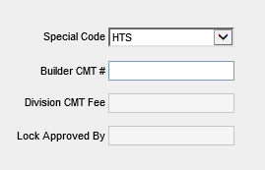
Steps in the HTS process
When locking the loan with the lender credit (Buyer’s buyer loan), you will need to select the special code “HTS” in the M/I Loan Pricing Summary.
2. Provide the Borrower with the ‘House to Sell Addendum’. This document can be found on the Intranet under Branch Reference Materials > Operations Reference Materials.
  The top section will need to be completed with the Sales Price and Realtor Information.
  This will be uploaded to the eFolder under ‘Disclosures’ and labeled as House to Sell Addendum on the loan of the individual that is buying the M/I Homes purchasers existing home.

Slide 5
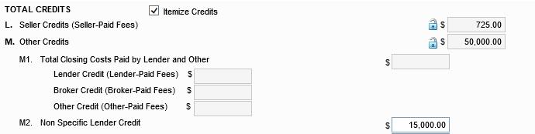
Steps in the HTS process
3. The total contribution will be entered as a Lump Sum Lender Credit in 2015 Itemization section M2. Non Specific Lender Credit

Slide 6
Steps in the HTS process
4. On the day of closing for their existing loan, the Branch will need to request funds from Corporate to pay for the Lender Credit. Send the following documents to Pam Hall at phall@mihomes.com.
• House to Sell Addendum
• GL Transfer Request
If you do not request funds, the Branch will inadvertently be charged the Lender Credit.
5. MIF Corporate will then forward your funds request to M/I Homes Accounting Department to the attention of Randy Green RGreen@MIHOMES.com and Kyle Isaacs kisaacs@MIHOMES.com to transfer the funds back to the Branch’s marketing gains account.
Note - This program cannot be used in conjunction with any other programs or promotions, or any special pricing requests. Loan products which are ineligible for sale through the GSE’s (Jumbo loans, Doctor loans, etc.) are not eligible to be utilized under this program.

Slide 7
HTS Example
Example:
Billy Buyer is purchasing an M/I Home and must sell his current home.
Billy is selling his current home for $500k.
Under the HTS program with M/I Financial, MIF will contribute 3% (15k) at closing, via lender credit as long as BOTH Billy Buyer (purchasing MIH) and his buyer (purchasing Billy’s house) use MIF.
Billy’s buyer must lock at rate sheet and pay 1% origination fee.
Closing must occur no later than 6 months AFTER closing of the MIH property.
Closing can be done as a back-to-back closing
****THIS PROGRAM DOES NOT AFFECT THE M/I HOMES BUYERS LOAN ***

Slide 8
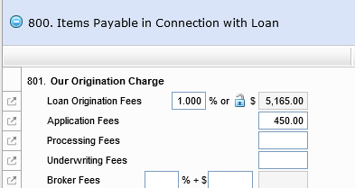
HTS Pricing & Lock
Go to the M/I Pricing Summary screen and select HTS
Then open OB and select desired pricing.
Add 1% origination fee to your 2015 Itemization

Slide 9
HTS Pricing & Lock
Enter the 3% Lender credit in the M2. Non Specific Lender Credit field of your 2015 Itemization screen.

Slide 10

HTS Flyer

Slide 11





